Slide 1

Meme Guide
Group Member: 廖若凡、罗丹、熊伟峰、陈子健

Slide 2
What are we working on?
梗百科开发
用户反馈
软件测试
Meme Guide Development
Gather Feedback From Users Around
Application Testing

Slide 3
Difficulty and effort of app development
Our work for the meme guide

Slide 4
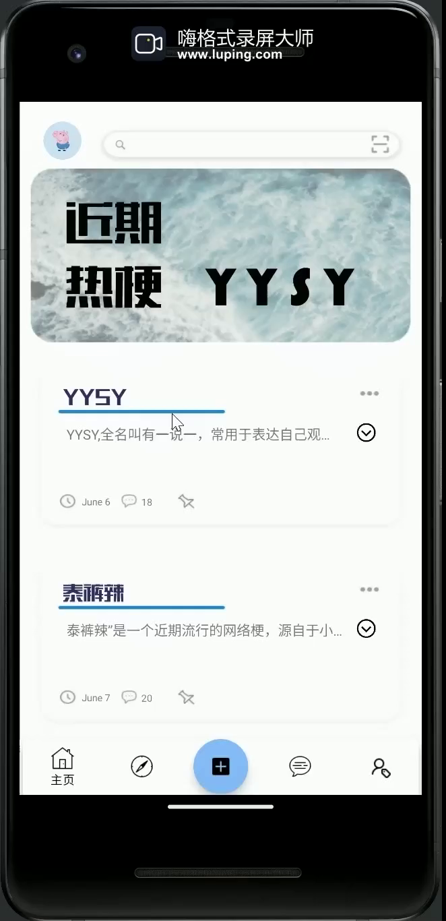
首页
Using RecyclerView, we created this homepage. It contains a search bar, an advertising window, a card list, and a navigation bar

Slide 5
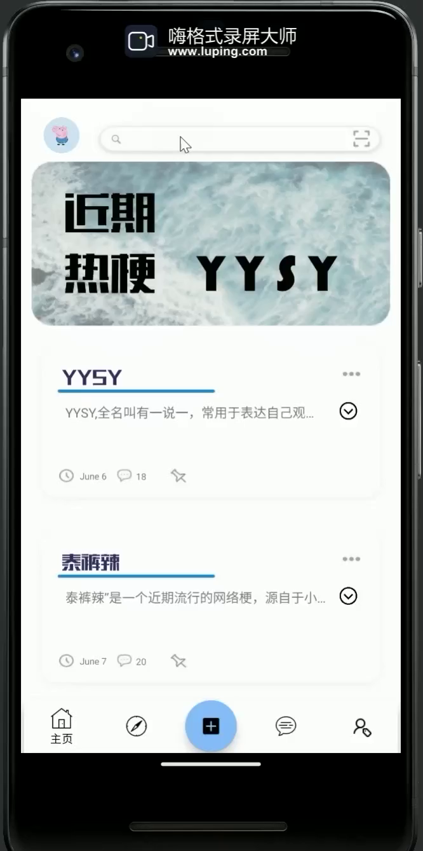
搜索页
Here users can search for the memes they want to know, and also we will give some search recommendations

Slide 6
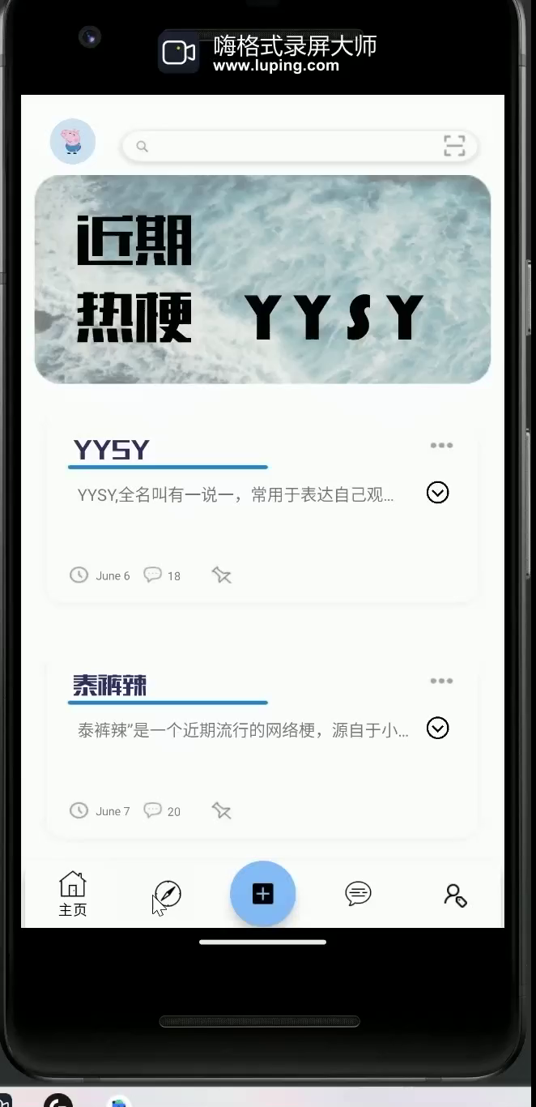
发现页
On this page, we want to give users a platform to interact with others, and if someone is confused about a meme, he/she can post a forum here for others to answer

Slide 7
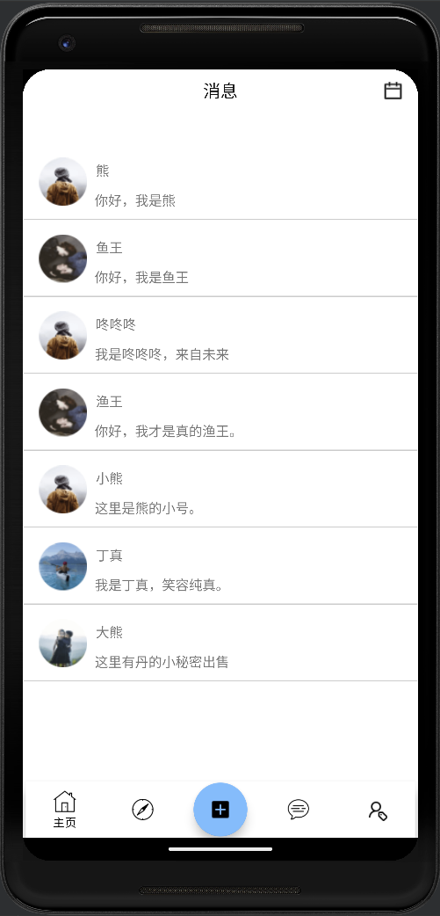
站内信
This is the page where users can chat with there subscribers and friends, our official announcement will also be published here

Slide 8
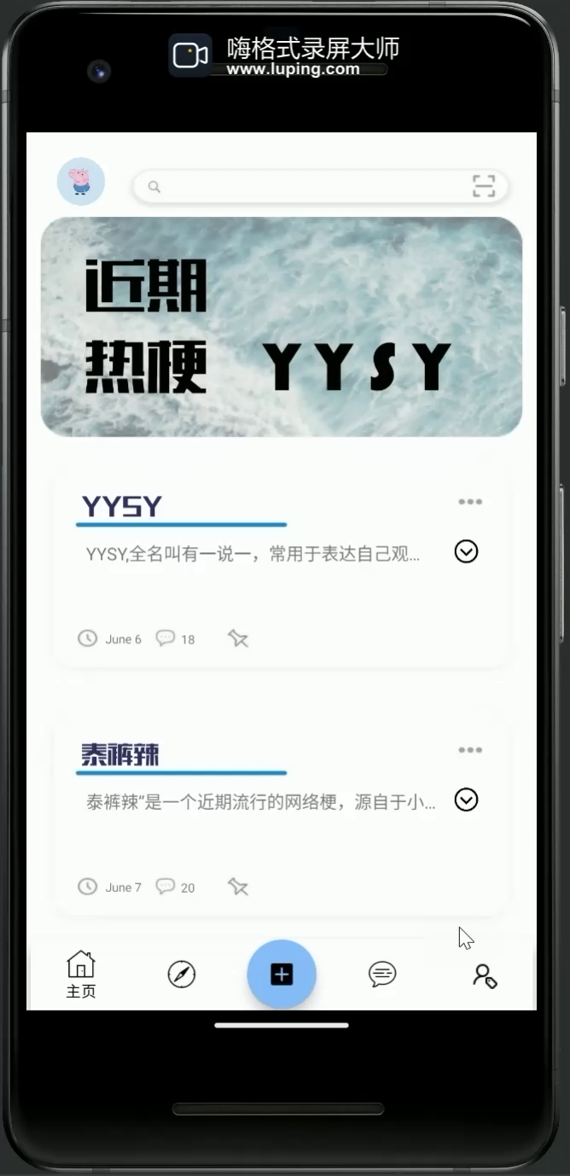
个人页
Using RecyclerView, we created this homepage. It contains a search bar, an advertising window, a card list, and a navigation bar

Slide 9

发布页
On this page user can easily edit their article, upload some pictures, save a draft or publish there own forum

Slide 10
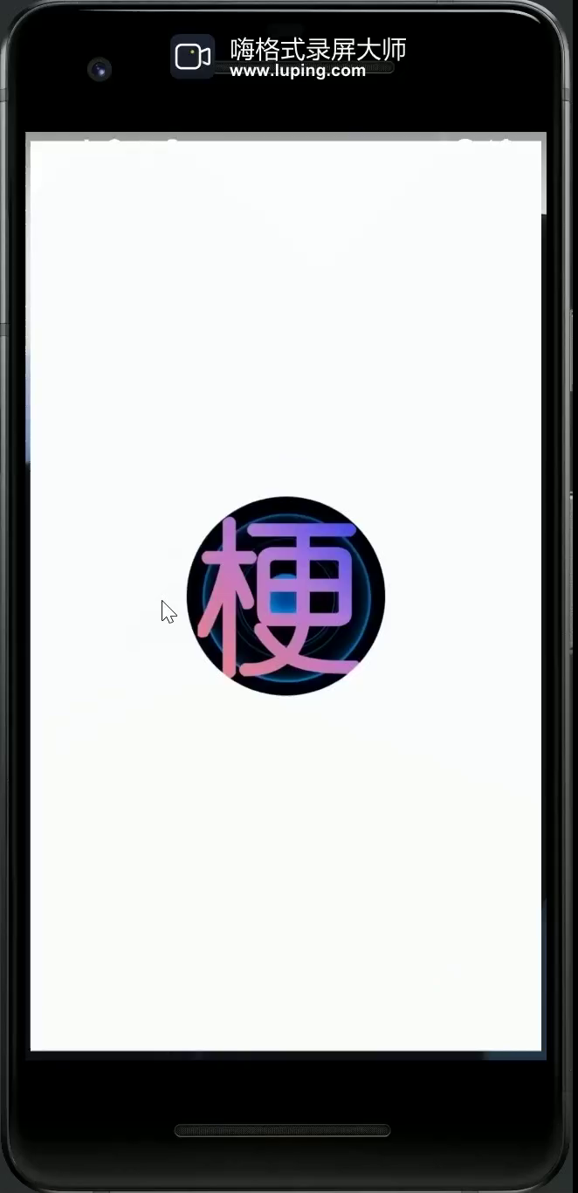
总览

Slide 11
The Completeness of the App Testing

Slide 12
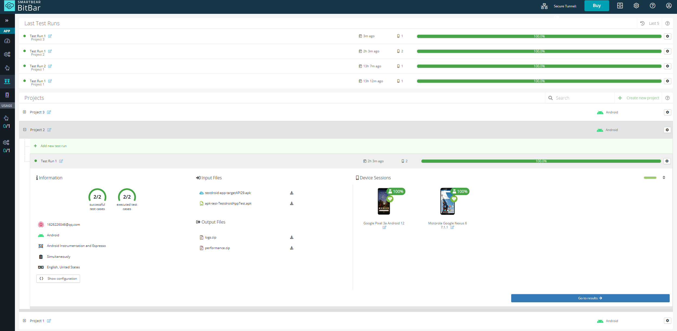

Slide 13
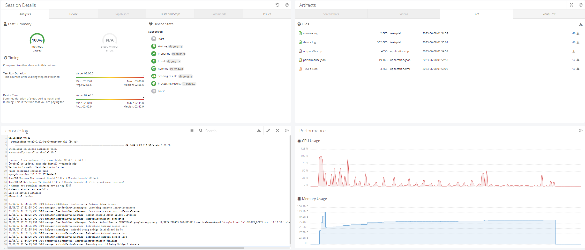

Slide 14
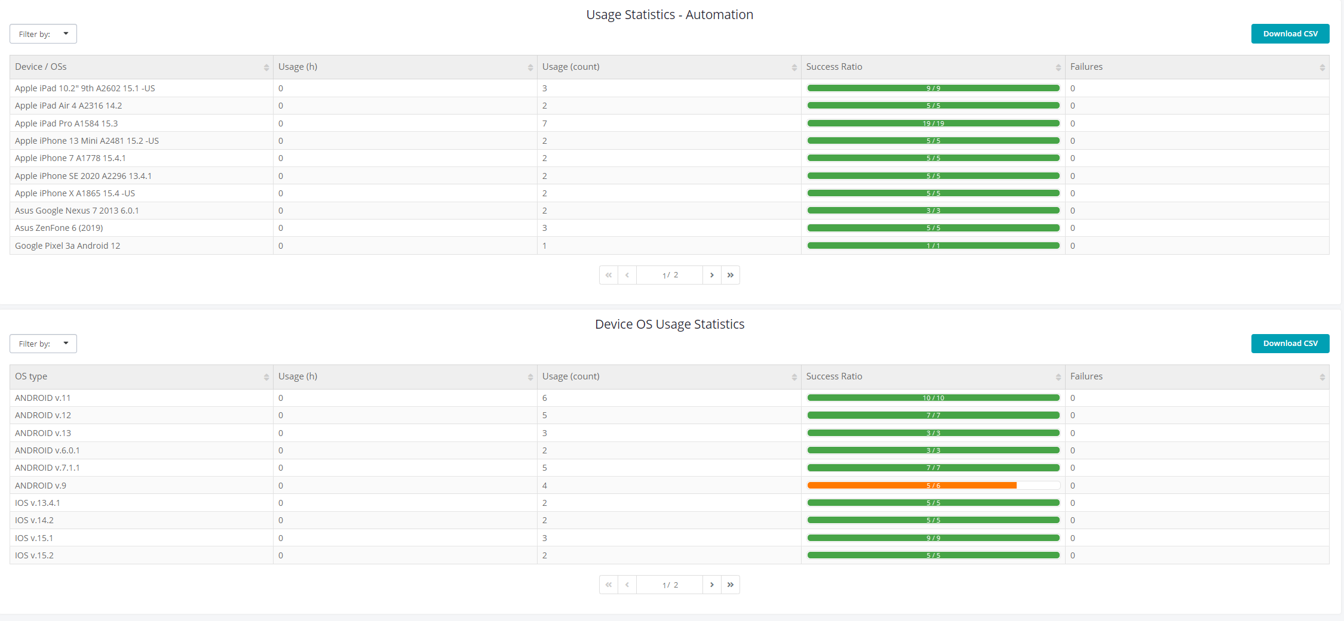

Slide 15
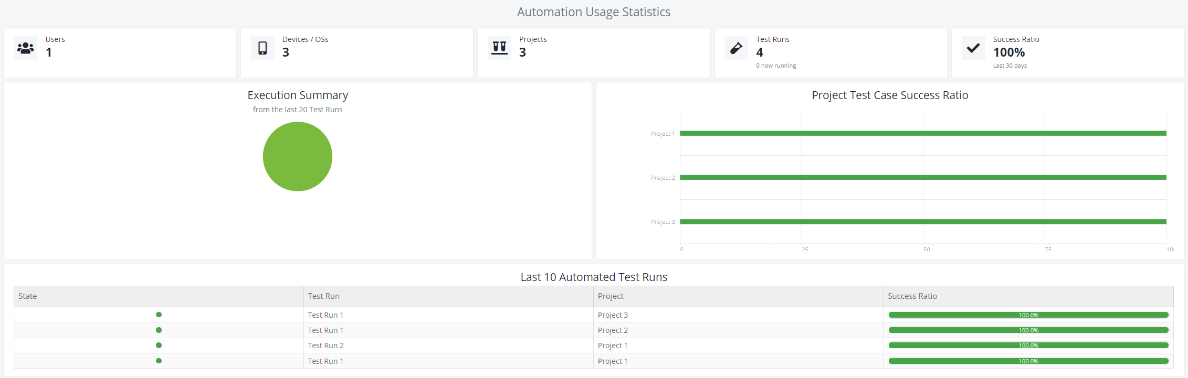

Slide 16
User experience and improvement effects

Slide 17
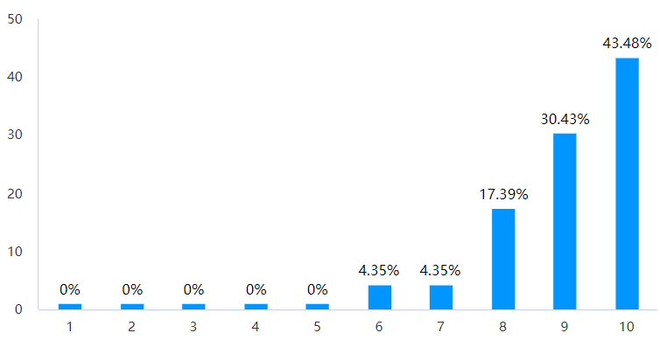
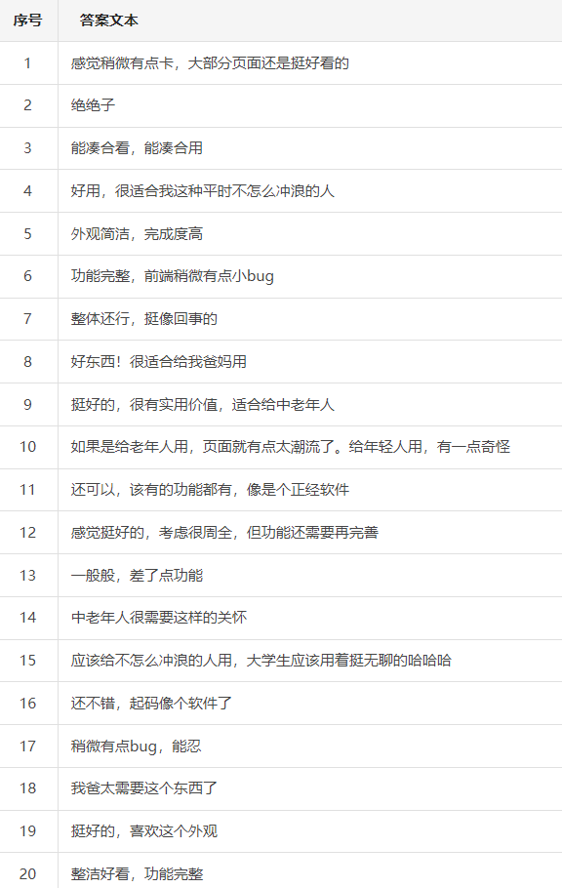


avg score: 9.04

Slide 18
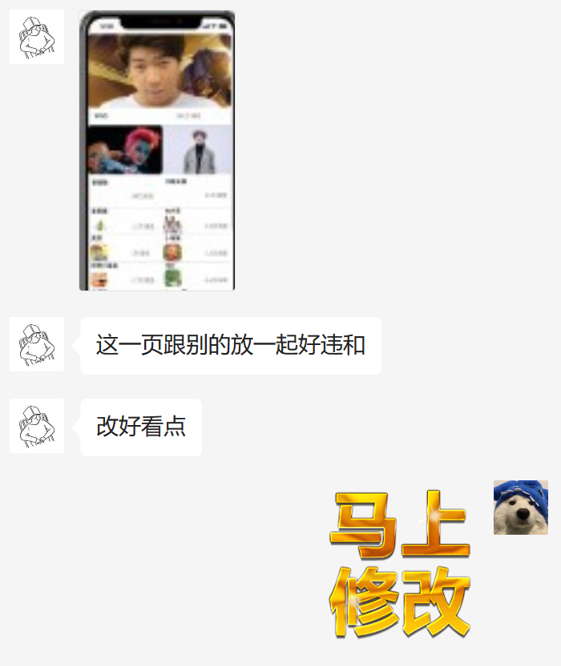
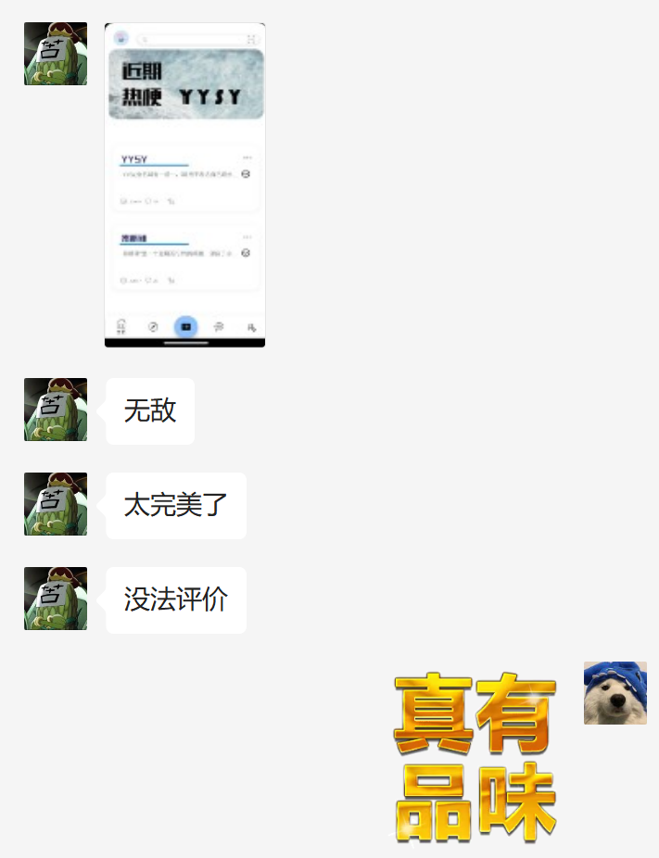
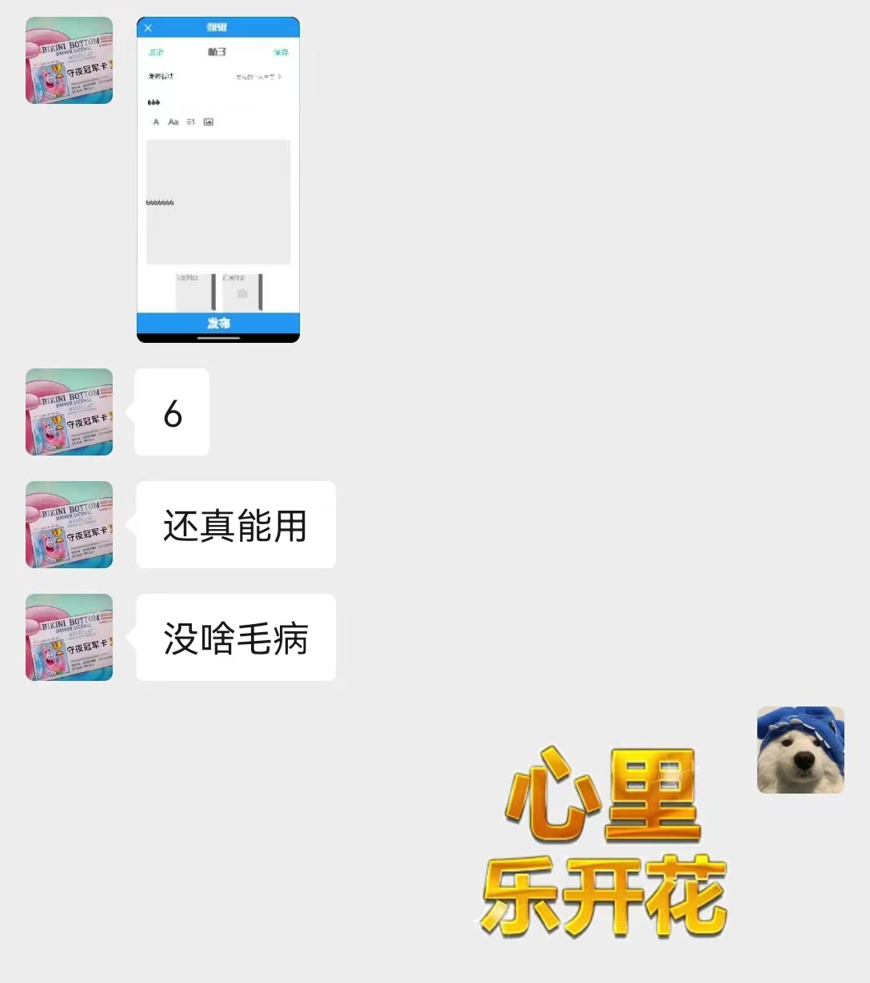

Slide 19
Responding to Feedback
美化界面
完善功能
修复部分bug
Beautify the Interface
Complete the Further Functions
Fix Some Known Bugs

Slide 20
Team division of labor and cooperation effectiveness
廖若凡
罗丹
布局设计与制作
ui动效
软件测试
用户反馈收集
PPT制作
前端交互
后端数据
原型布局实现
优化ui
搜索功能实现
熊伟峰
陈子健
前端交互
资料收集
组件设计
登录功能实现
录屏展示
原型布局实现
后端数据
页面美化
部分功能实现

Slide 21


Thanks

